Slide 1

Machine learning techniques
Unit - 3
Manish Kumar

Slide 2
Instance – based learning
Instance-based learning are the systems that learn the training examples by heart and then generalizes to new instances based on some similarity measure. It is called instance-based because it builds the hypotheses from the training instances. It is also known as memory-based learning or lazy-learning.
The time complexity of this algorithm depends upon the size of training data.
The worst-case time complexity of this algorithm is O (n), where n is the number of training instances.
Instance – based learning algorithms use the entire dataset as the model.
For Example:
K Nearest Neighbor (KNN)
Self-Organizing Map (SOM)
Learning Vector Quantization (LVQ)
Locally Weighted Learning (LWL)

Slide 3
Instance – based learning
Advantages:
Instead of estimating for the entire instance set, local approximations can be made to the target function.
This algorithm can adapt to new data easily, one which is collected as we go .
Disadvantages:
Classification costs are high
Large amount of memory required to store the data, and each query involves starting the identification of a local model from scratch.

Slide 4
K-nearest neighbors
KNN Can be used for both classiﬁcation and regression problems. KNN stores all available cases and classiﬁes new cases by a majority vote of its K neighbors.
K-NN algorithm assumes the similarity between the new case/data and available cases and put the new case into the category that is most similar to the available categories.
K-NN is a non-parametric algorithm, which means it does not make any assumption on underlying data.
It is also called a lazy learner algorithm because it does not learn from the training set immediately instead it stores the dataset and at the time of classification, it performs an action on the dataset.

Slide 5
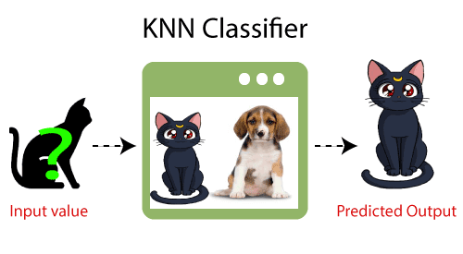
K-nearest neighbors

Slide 6
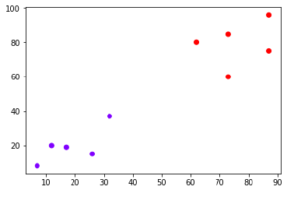
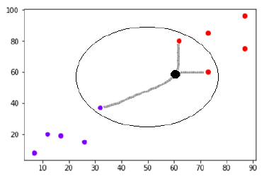
K-nearest neighbors
Suppose we have a dataset which can be plotted as follows −
Now, we need to classify new data point with black dot (at point 60,60) into blue or red class. We are assuming K = 3 i.e. it would find three nearest data points. It is shown in the next diagram.
We can see in the 2nd diagram the three nearest neighbors of the data point with black dot. Among those three, two of them lies in Red class hence the black dot will also be assigned in red class.

Slide 7
K-nearest neighbors
How does KNN work:
Step-1: Select the number K of the neighbors
Step-2: Calculate the Euclidean distance of K number of neighbors
Step-3: Take the K nearest neighbors as per the calculated Euclidean distance.
Step-4: Among these k neighbors, count the number of the data points in each category.
Step-5: Assign the new data points to that category for which the number of the neighbor is maximum.
Step-6: Our model is ready.

Slide 8
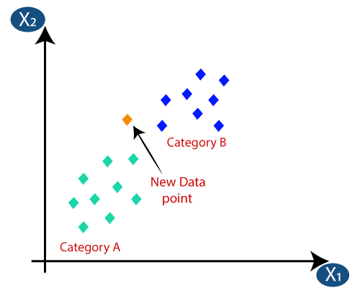
K-nearest neighbors
Suppose we have a new data point and we need to put it in the required category. Consider the below image:
Firstly, we will choose the number of neighbors, so we will choose the k=5.
Next, we will calculate the Euclidean distance between the data points. The Euclidean distance is the distance between two points, which we have already studied in geometry. It can be calculated as:

Slide 9
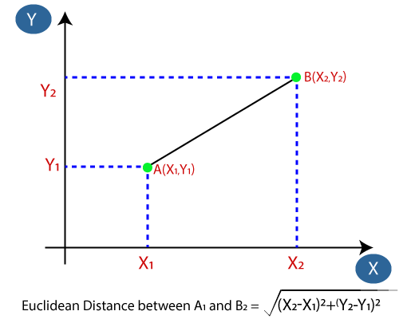
K-nearest neighbors
By calculating the Euclidean distance we got the nearest neighbors, as three nearest neighbors in category A and two nearest neighbors in category B. Consider the image show on next slide:

Slide 10
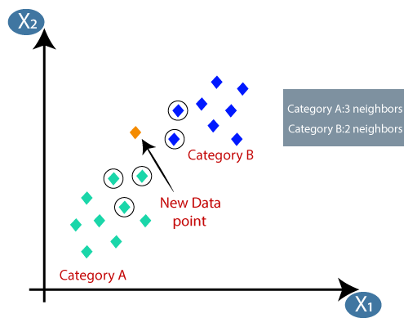
K-nearest neighbors
As we can see the 3 nearest neighbors are from category A, hence this new data point must belong to category A.

Slide 11
K-nearest neighbors
How to select the value of K in the K-NN Algorithm?
The value of k is non-parametric and a general rule of thumb in choosing the value of k is k = sqrt(N)/2, where N stands for the number of samples in your training dataset.
Another tip that I suggest is to try and keep the value of k odd, so that there is no tie between choosing a class.

Slide 12
K-nearest neighbors
Advantages of KNN Algorithm:
It is simple to implement.
It is robust to the noisy training data
It can be more effective if the training data is large.
Disadvantages of KNN Algorithm:
Always needs to determine the value of K which may be complex some time.
The computation cost is high because of calculating the distance between the data points for all the training
samples.

Slide 13
K-nearest neighbors
Independent and Dependent Variables:
The independent variable is the cause. Its value is independent of other variables in your study. The dependent variable is the effect. Its value depends on changes in the independent variable.
Example:
How long you sleep (independent variable) affects your test score (dependent variable). This makes sense, but: Example: Your test score affects how long you sleep.
The easiest way to identify which variable in your experiment is the Independent Variable (IV) and which one is the Dependent Variable (DV) is by putting both the variables in the sentence below in a way that makes sense.
“The IV causes a change in the DV.”

Slide 14
K-nearest neighbors
Can KNN be used for regression?
Yes, K-nearest neighbor can be used for regression. In other words, K-nearest neighbor algorithm can be applied when dependent variable is continuous. In this case, the predicted value is the average of the values of its k nearest neighbors.
Why KNN is non-parametric?
Non-parametric means not making any assumptions on the underlying data distribution. Non-parametric methods do not have fixed numbers of parameters in the model. Similarly in KNN, model parameters actually grows with the training data set - you can imagine each training case as a "parameter" in the model.

Slide 15
K-nearest neighbors
For Numerical Examples click on below link:
Numeric Examples

Slide 16
THANK YOU
manish.kumar@niet.co.in

